Slide 1


Welcome Everyone!
We’ll be starting at 10:05 AM PDT

Slide 2
The National Research Platform
Fall Training Series
Mohammad Firas Sada
University of California, San Diego
San Diego Supercomputer Center

Slide 3
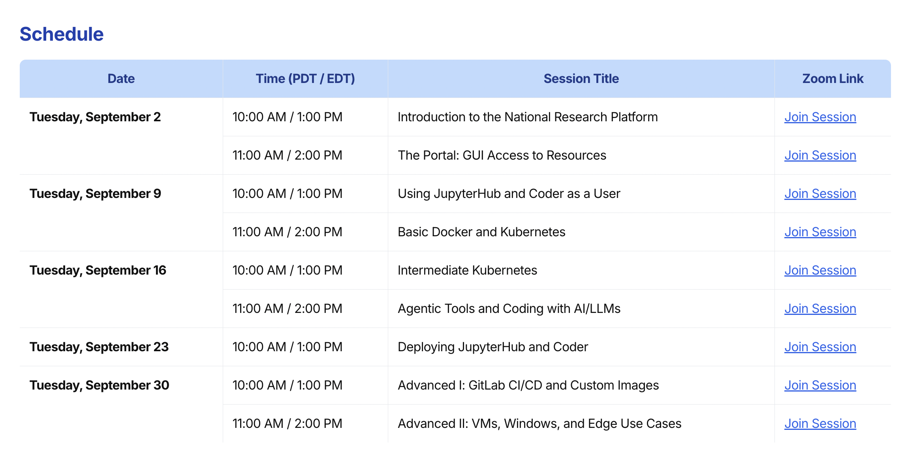
https://nrp.ai/training/

Slide 4
Important Notice
This training is intended as a supplement to the official NRP Documentation.
While the content presented here is accurate as of today, the official documentation is the primary and most up-to-date source of truth.
Please refer to https://nrp.ai/documentation/ for the latest information and updates.

Slide 5
Repository Link
https://github.com/nrp-nautilus/fall25training
https://nrp.ai/documentation/userdocs/jupyter/jupyterhub
https://z2jh.jupyter.org/en/stable/
Docs Page
JupyterHub Docs (for Kubernetes):

